Slide 1
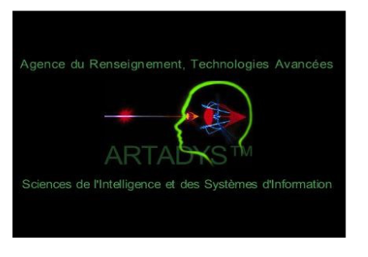

ARTADYS
Spatial Inner Dynamic Connectivity
Predict live the Human behaviour
https://artadys.com/
Esomar Research Rallye June 2017,22th
Christine Caggia (Askia) /Hervé Tranger (BVA)

Slide 2
Company
Created in 2006 , by Neuro scientists Cristian Beza & Ankit Singhal, Marco Tatta , Jerald L. Feinstein
NSA, FBI technologies (Satellite, global listening, etc…)
Surveillance of things and human behaviour
Emotion, personalities , mindshare , local share, customer intimacy, geolocation

Slide 3
Data and Analytics
Insight Global Live engine in one round :
Url censing
Text analysis (picture analysis with computer vision in progress)
Psychometric analysis (behavioural approach)
Geolocation, attitude, spatial merging and mindshare clustering
Aerotech Vision ➔ Human / Vehicules counts
Dataviz
Based on public data :
Global listening
Satellite data

Slide 4
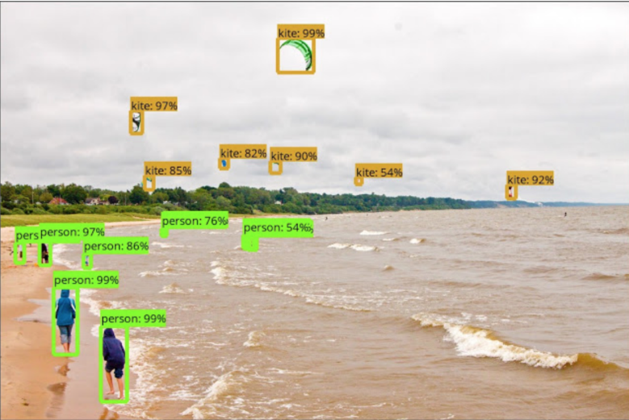
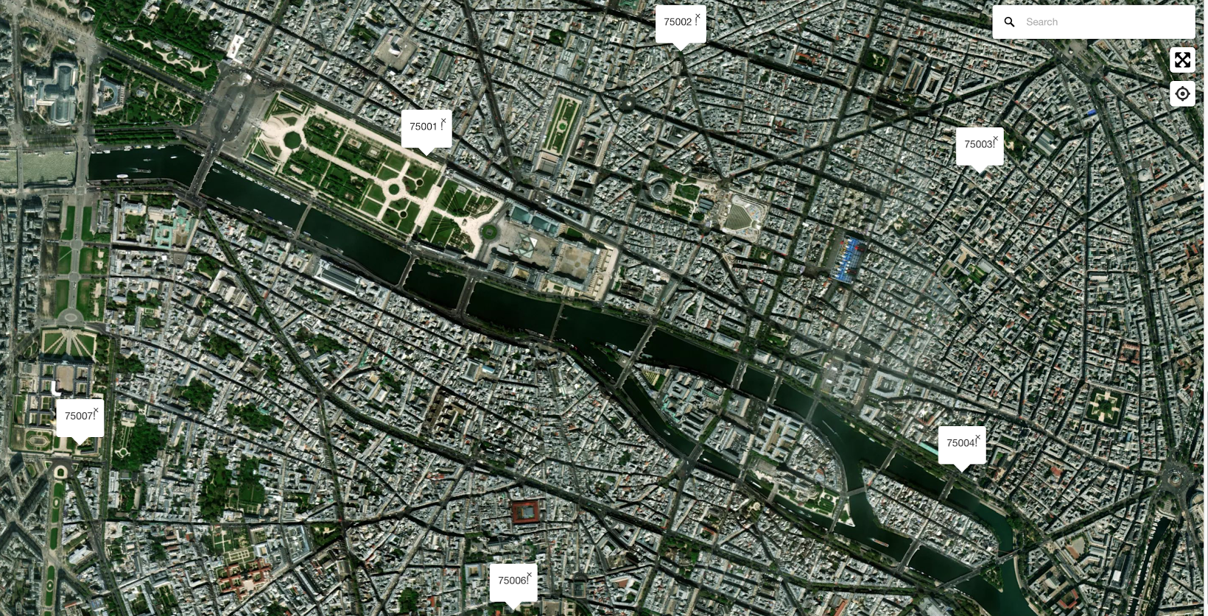
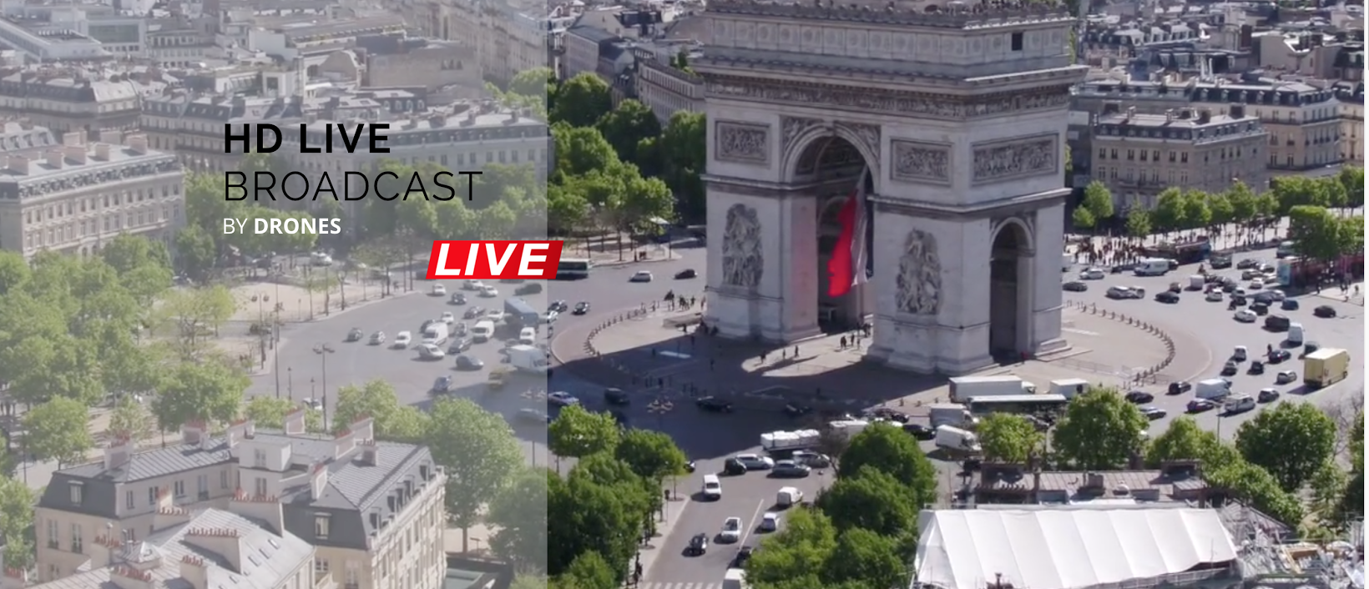

Slide 5
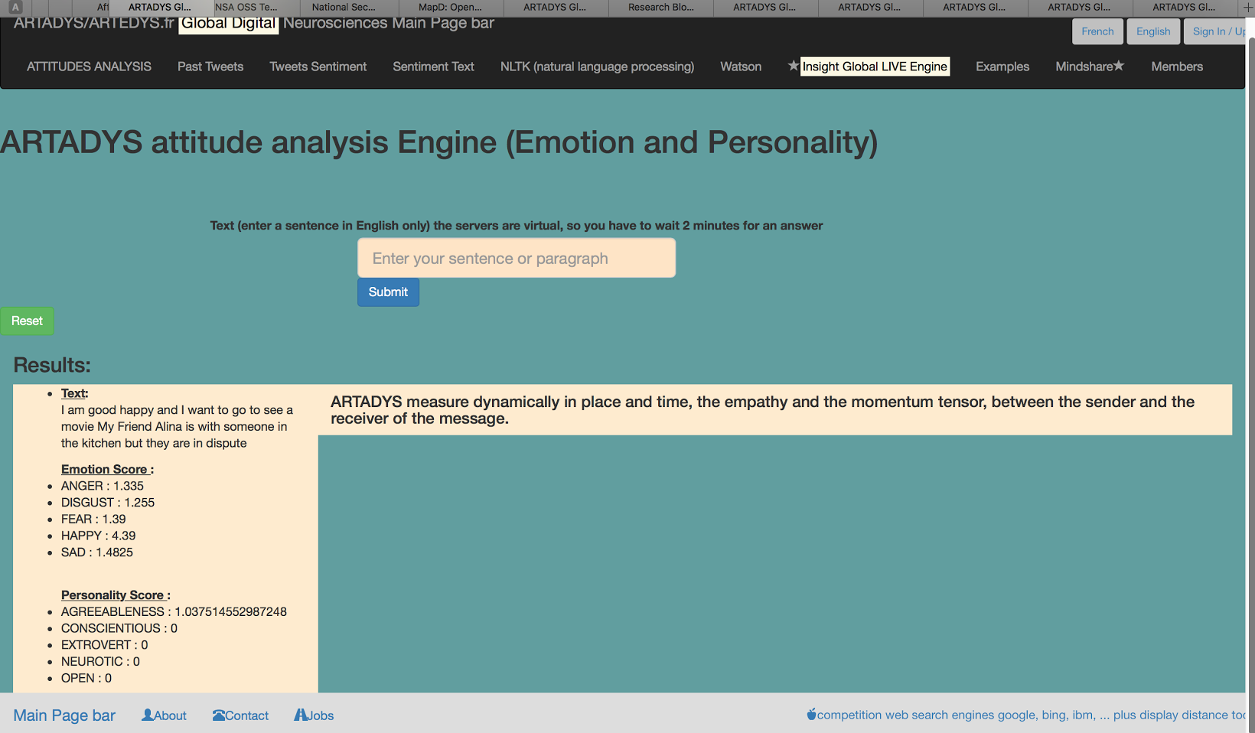

Slide 6
Case Studies: Media planning “Out of the room”
“ The right message to the right community at the right time”
Advantages | Insights
High “viral” spread and mobility | Audience (push and measure)
Location base (zoning) | Churn & loyalty

Slide 7
Example 1: Roland Garros and BNP
=> Efficiency of the media planning
Zoning : where we have more concern people (Core target)
=> satellite , web social listenning
2) Push on digital board the message “BNP partenaire de Roland Garros”
Measure of increase of citations number
= > Feelings analysis (attitudes)

Slide 8
Benefits client
Live & dynamic measure - Cost reduction & Efficiency increase
Targeted communication
Speak about real people (Remove any bot interaction : - 75%)
Targets client
Advertisers
Media agencies
Politics
Example 1 : Media Planning

Slide 9
Example 2: Predictive on augmented reality
=> Determine the level from which the Trigger is changing the attitude
Listen in of interaction graph
We introduce new events
=> New product, colour, flagrance
We see the augmented reality on graph changes

Slide 10
Benefits client
Simulation and prediction on market (inc competition)
Simulation of crisis
Targets client
Brands / Advertisers
Government and Security agencies
Politics
Example 2 : Predictive on augmented reality

Slide 11
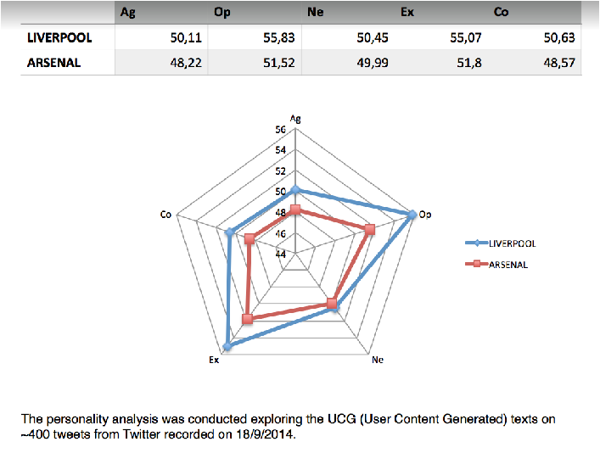
Example 3: B To C “real estate”
Use the qualification of territory in consumers app (SDK) in order to help people to make the good choose in a location question
Search for information
Push local information => accuracy on decision
Think => Act

Slide 12
Benefits client
Communication to real people (empathy)
Accuracy of information
Targets client
Hôtel reservation, R’BnB …
Travel agencies, Tourism
Local authorities
Example 1 : BtoC

Slide 13
The change
What is the value of Artadys :
Artadys gives insight from:
global listening analysis and psychometric measures
crossed by a clustering zoning
to optimise the choice with a spatial aspect
The hackaton benefits :
From the engineer language to a marketing language

Slide 14
Merci

